Slide 1

Deep Vision
Lecture 1: Introduction
蔣依吾
資訊工程學系
國立中山大學

Slide 2
1. University of Michigan Lecture 1: Introduction to Deep Learning for Computer Vision – YouTube 2. MIT MIT Introduction to Deep Learning | 6.S191 – YouTube 3. TUM Introduction to Deep Learning - 1. Introduction – YouTube 4. Deep Learning by Goodfellow, Bengio, and Courville GitHub - janishar/mit-deep-learning-book-pdf: MIT Deep Learning Book in PDF format (complete and parts) by Ian Goodfellow, Yoshua Bengio and Aaron Courville

Slide 3
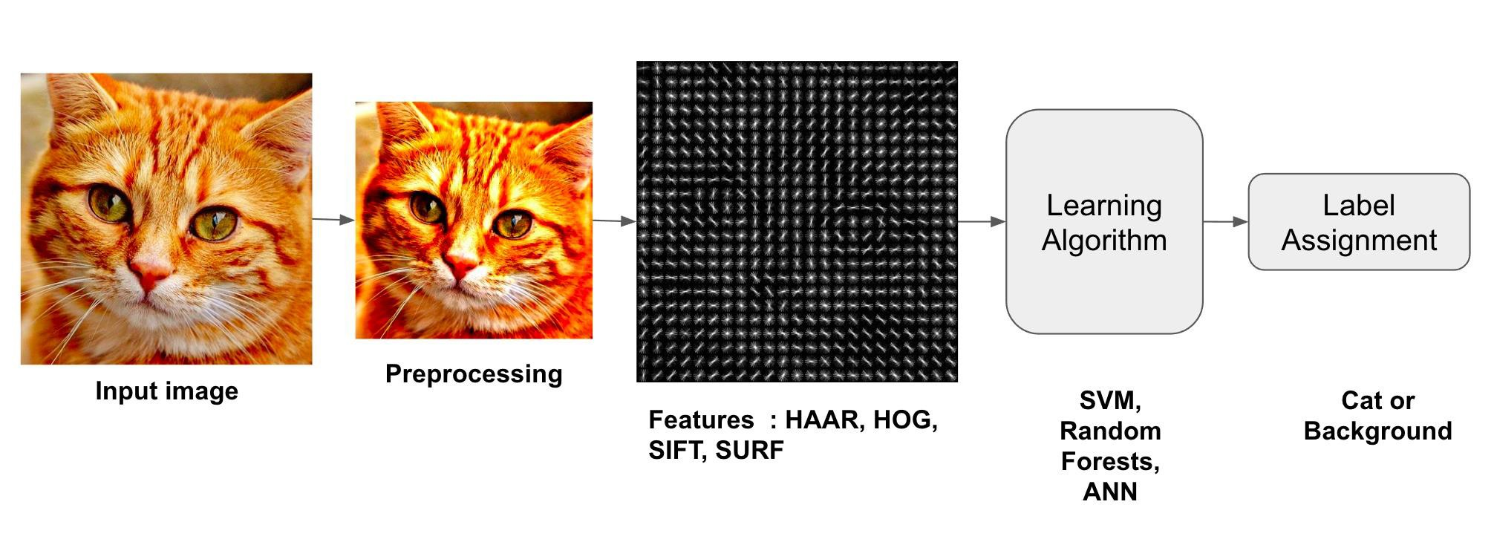
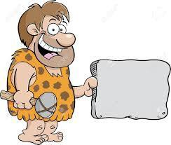
Image Classification

Slide 4
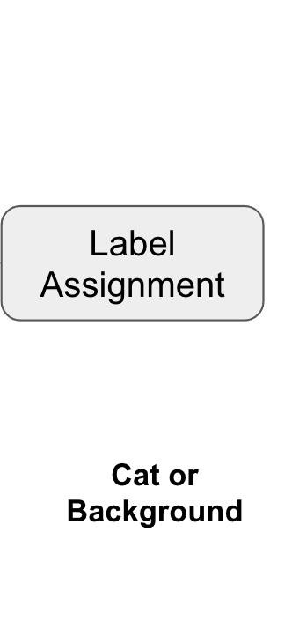
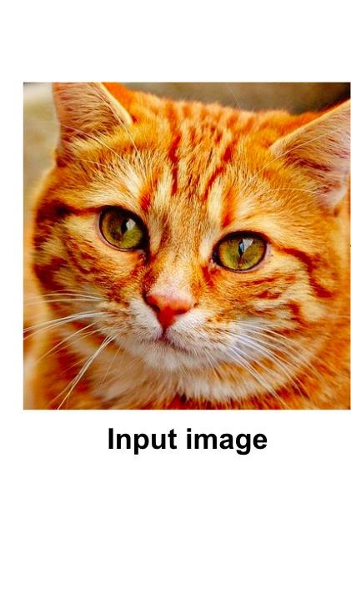
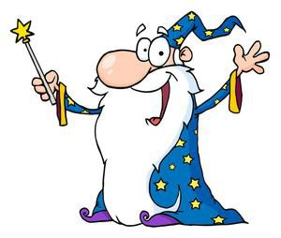
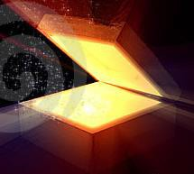
Image Classification
Awesome
magic box
Open the box
Become magicians
Post 2012

Slide 5
Rules
Traditional
programming
Answers
Data
Answers
Machine
learning
Rules
Data
Model
(Rules)
Data
Answers

Slide 6
To create order out of chaos
-> To derive rules out of big data
6

Slide 7
Deep Learning for Computer Vision
Building artificial systems that process, perceive, and reason about visual data
-> Mimic the human visual system
-> Center block of robotic intelligence

Slide 8
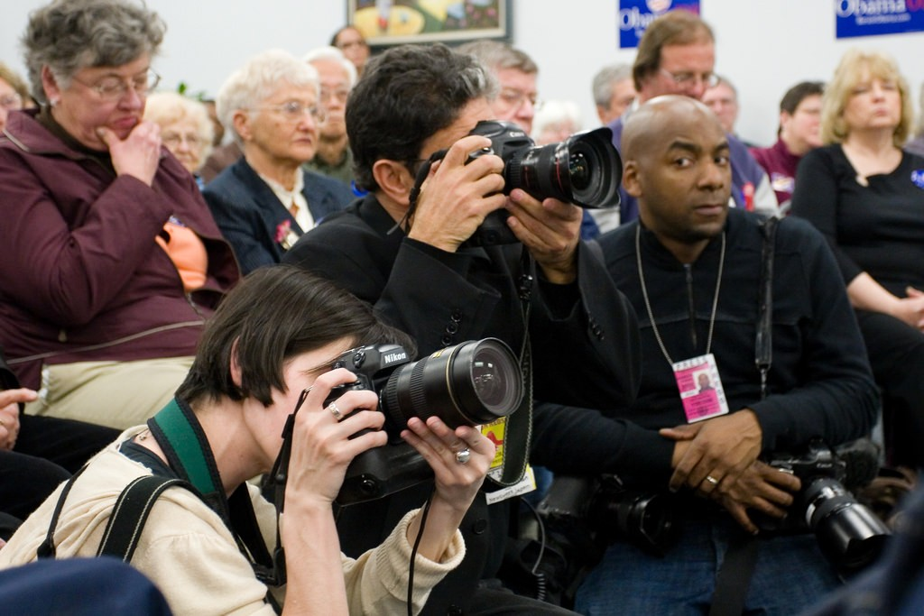
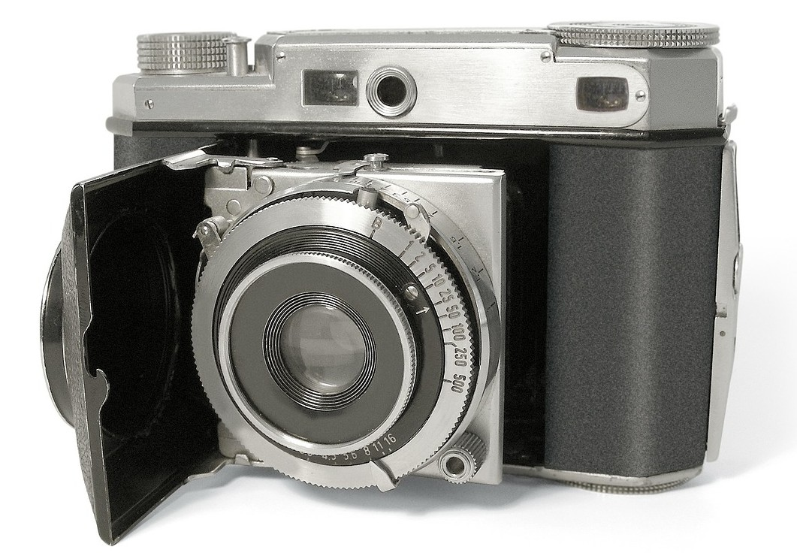
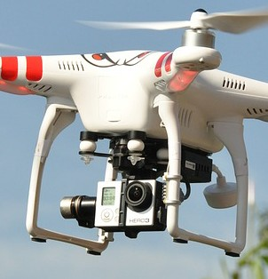
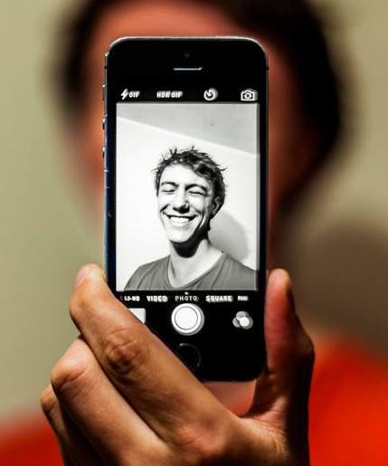
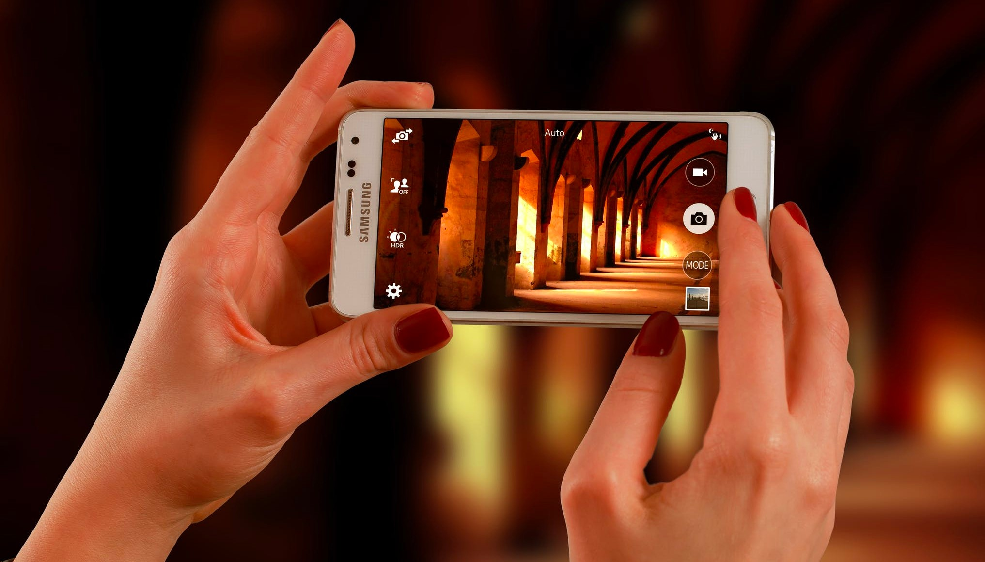
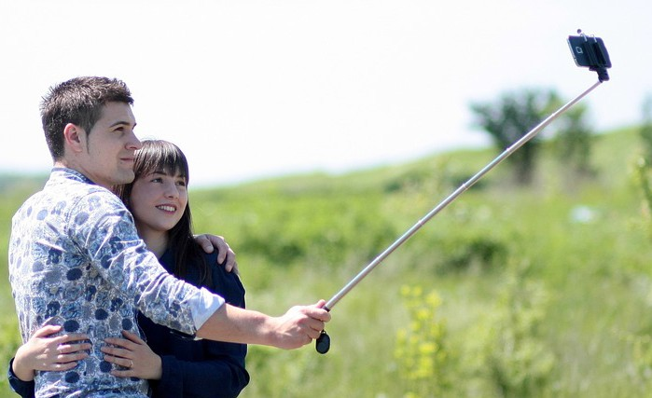
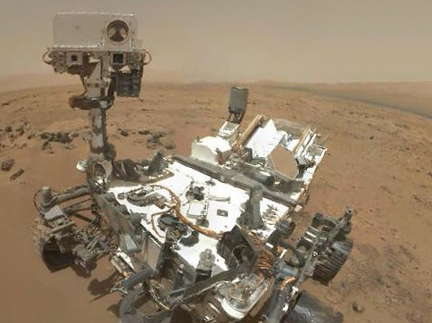
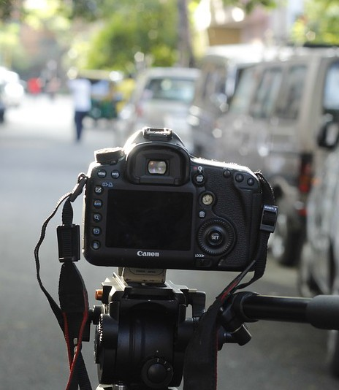
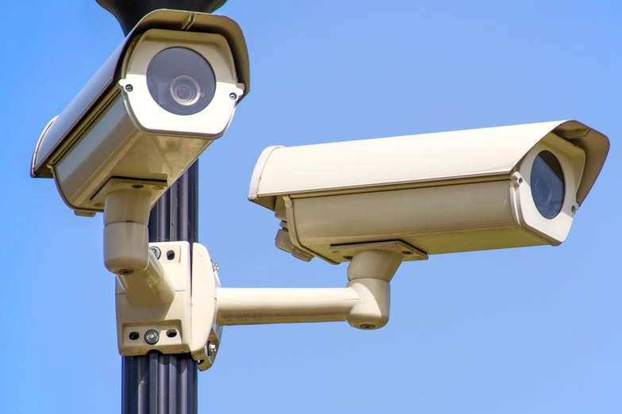
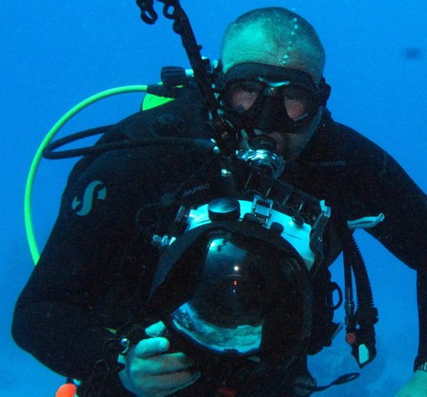
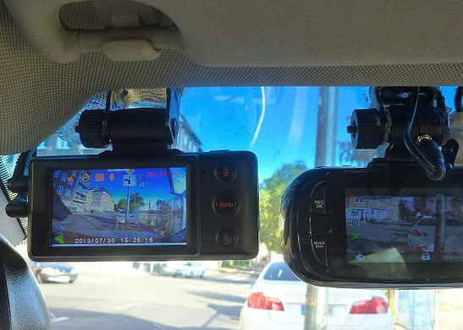
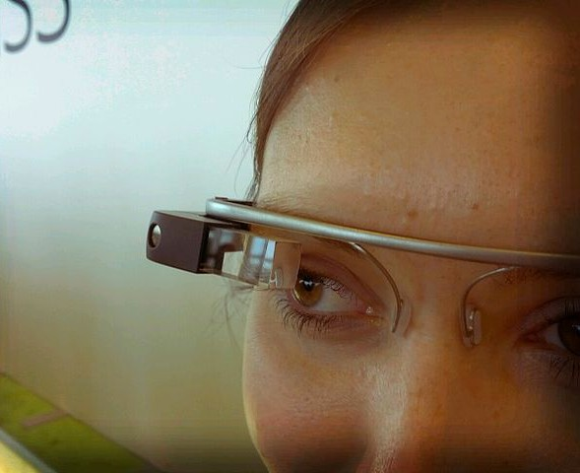
Computer Vision is everywhere!
Left to right:
Image by Roger H Goun is licensed under CC BY 2.0
Image is CC0 1.0 public domain Image is CC0 1.0 public domain Image is CC0 1.0 public domain
Left to right: Image is free to use
Image is CC0 1.0 public domain Image by NASA is licensed under CC BY 2.0
Image is CC0 1.0 public domain
Bottom row, left to right Image is CC0 1.0 public domain Image by Derek Keats is licensed under CC BY 2.0; changes made Image is public domain Image is licensed under CC-BY 2.0; changes made

Slide 9
Deep Learning for Computer Vision
Building artificial systems that learn from data and experience

Slide 10
Deep Learning for Computer Vision
Hierarchical learning algorithms with many “layers”, (very) loosely inspired by the brain

Slide 11
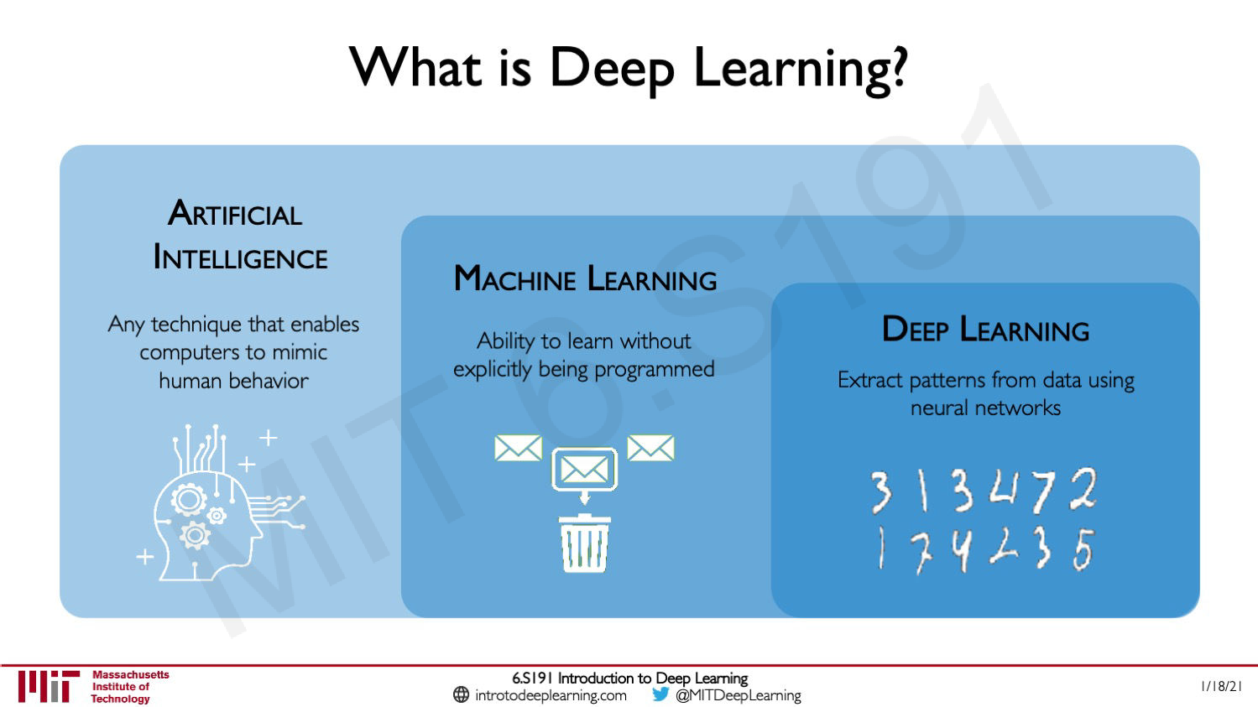
What is Deep Learning?
11

Slide 12
Artificial Intelligence
Machine Learning
Computer Vision
Deep Learning

Slide 13
This class
Artificial Intelligence
Machine Learning
Computer Vision
Deep Learning

Slide 14
This class
Artificial Intelligence
Machine Learning
Computer Vision
Deep Learning
Natural Language
Processing

Slide 15
This class
Artificial Intelligence
Machine Learning
Computer Vision
Deep Learning
Natural Language
Speech
Processing
Recognition

Slide 16
This class
Artificial Intelligence
Robotics
Machine Learning
Computer Vision
Deep Learning
Natural Language
Speech
Processing
Recognition

Slide 17
Why Deep Learning and Why Now?

Slide 18
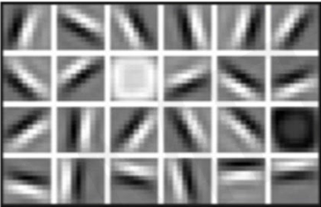
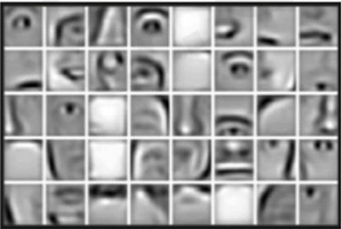
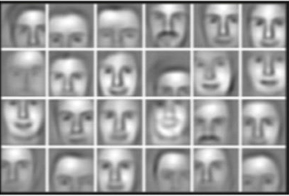
Why Deep Learning?
Hand engineered are time consuming,brittle,and not scalable in practice
Can we learn the underlying features directly from data?
Low Level Features
Low Level Features
Low Level Features
Lines & Edges
Eyes &Nose&Ears
Facial Structure
18

Slide 19
What made this possible?
Big Data
Hardware
Deep
Models know where to learn from
Models are
trainable
Models are
complex

Slide 20
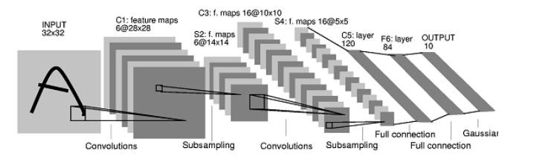
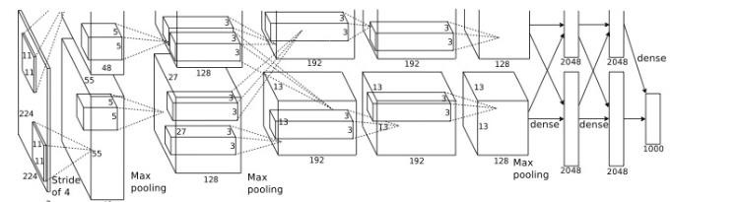
What has Changed?
MNIST digit
recognition dataset
10⁷ pixels used in training
ImageNet image
recognition dataset
10¹⁴ pixels used in training
1998
LeCun et al.
2012
Krizhevsky et al.

Slide 21
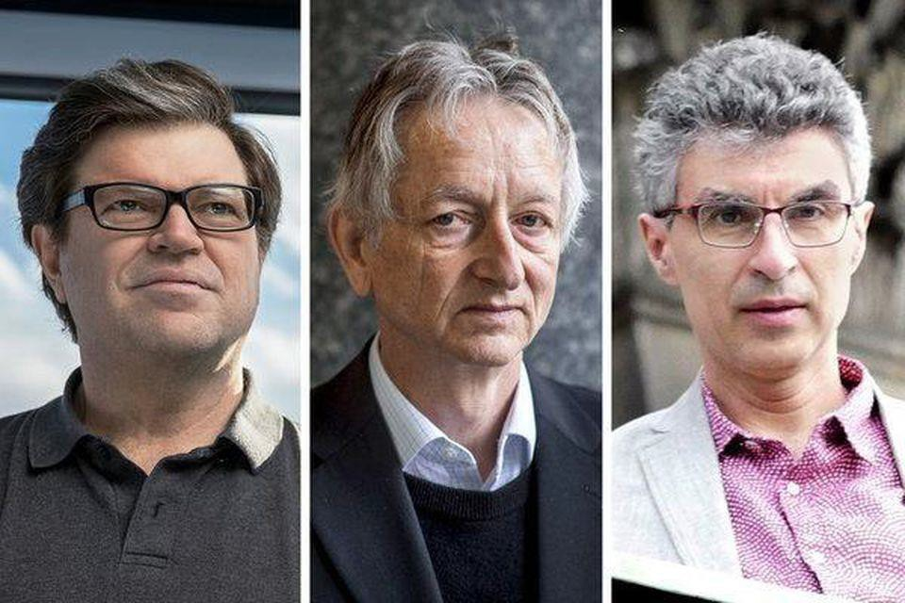
Deep Learning Recognition
ACM Turing Award 2019 (Nobel Prize of Computing)
Yann LeCun, Geoffrey Hinton, and Yoshua Bengio

Slide 22
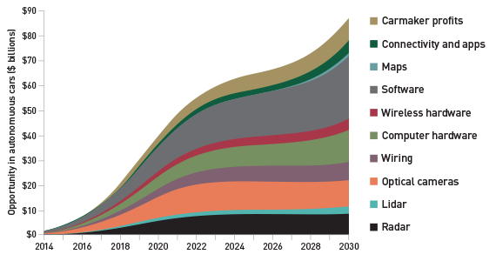
Deep Learning Market
[…]Market research report Deep Learning Market […]‘’the deep learning market is expected to be worth USD 1,722.9 Million by 2022

Slide 23
Deep Learning Job Perspect i ve
Excellent Job Perspectives!
Automation requires ML/DL -> growth!
Top-notch companies will gladly hire you!
Many industries now:
IT-Companies
Cars, Logistic, Health Care, etc…
Manufacturing / Robotics, etc…

Slide 24
But Also Challenging
High-level understanding is not enough
Need proper theory background
Need proper practical skillsets
Can be competitive!
Many good people
Downloading scripts / running code not enough ☺
Deeper understanding often requires PhDs

Slide 25
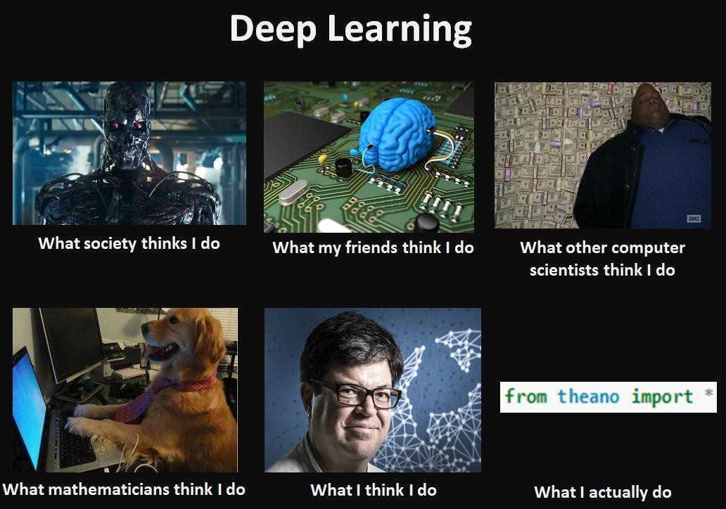
Deep Learning Memes

Slide 26
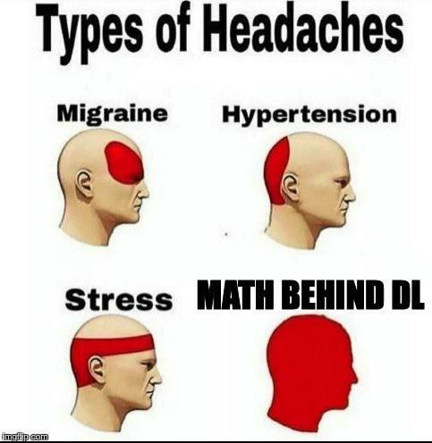
Deep Learning Memes

Slide 27
Today’s Agenda
A brief history of computer vision and deep learning

Slide 28
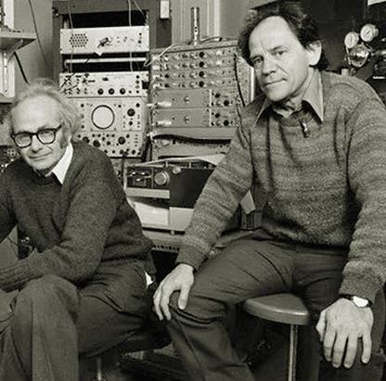
Hubel and Wiesel
David Hubel and Torsten Wiesel were neurobiologists from Harvard Medical School
Experiment revealed several secrets of the human vision system
Won 2 Nobel prizes (1981)

Slide 29
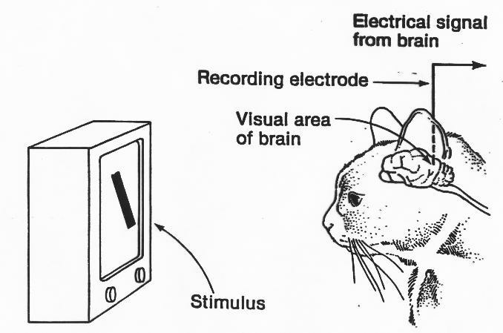
Hubel and Wiesel Experiment
Recorded electrical activity from individual neurons in the brains of cats.
Slide projector to show specific patterns to the cats noted specific patterns stimulated activity in specific parts of the brain.
Results: Visual cortex cells are sensitive to the orientat ion of edges but insensitive to t heir position

Slide 30
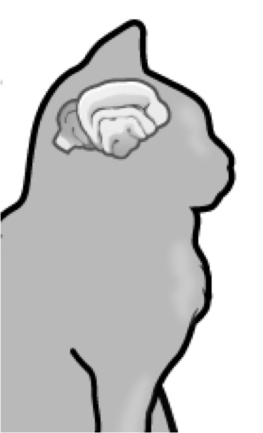

Simple cells: Response to light orientation
Complex cells:
Response to light
orientation and movement
Hypercomplex cells: response to movement with an end point
Cat image by CNX OpenStax is licensed under CC BY 4.0; changes made
1959
Hubel & Wiesel
Response
Stimulus
No response

Slide 31
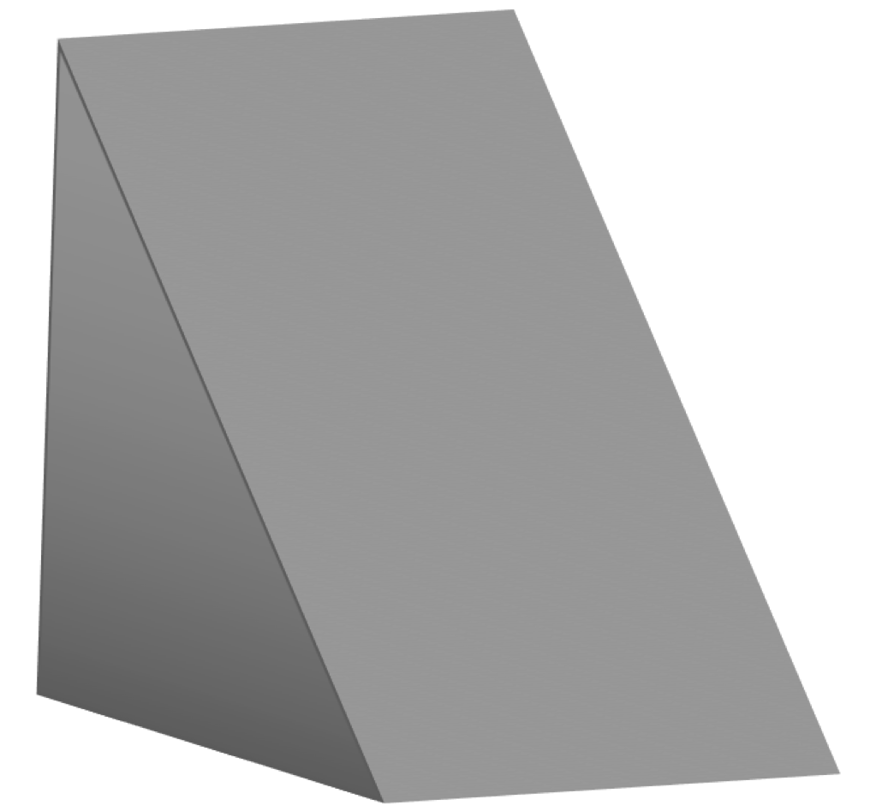
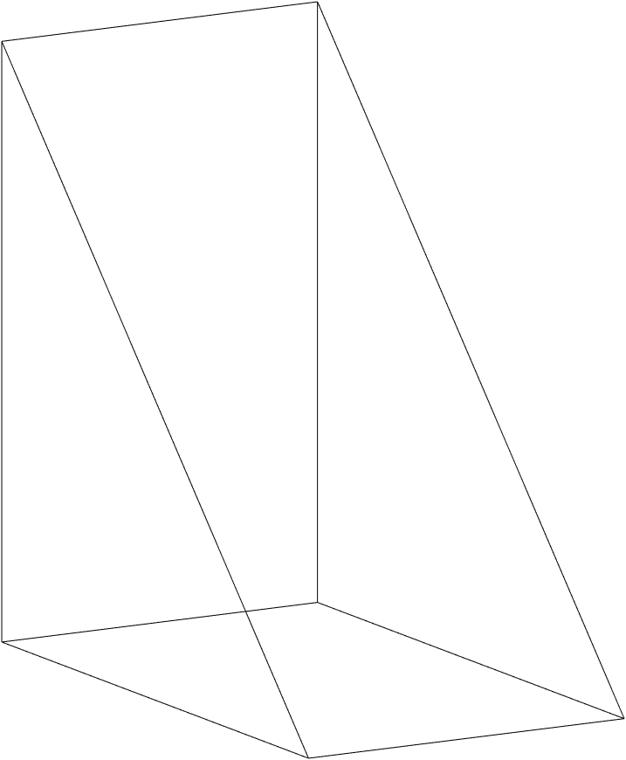
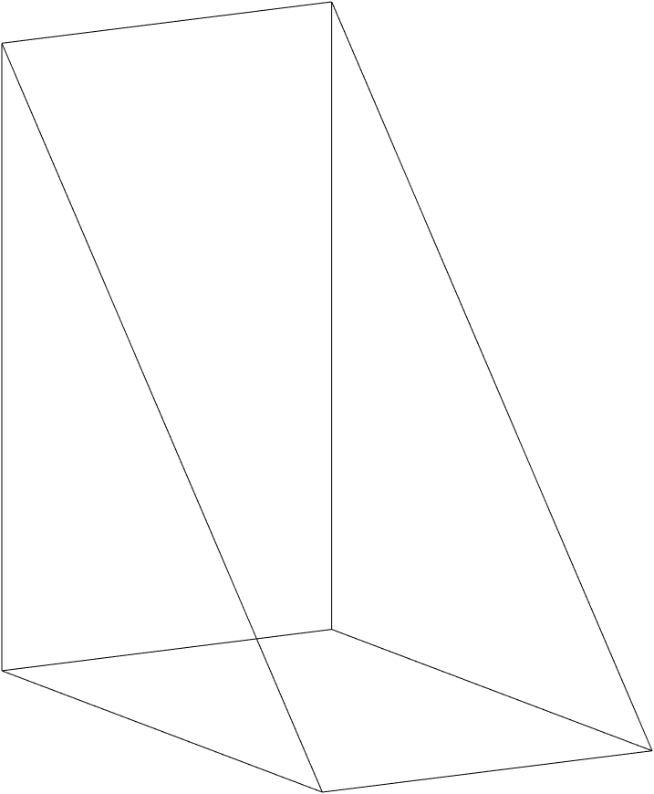
Larry Roberts, 1963
(a) Original picture
(b) Differentiated picture
(c) Feature points selected
1959
Hubel & Wiesel
1963
Roberts

Slide 32
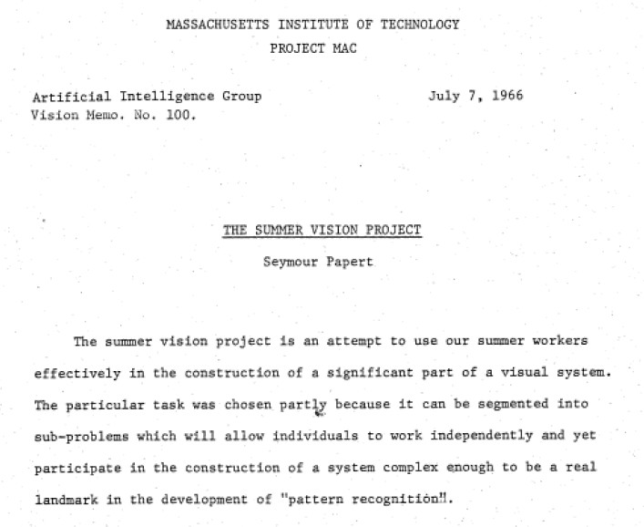
1959
Hubel & Wiesel
1963
Roberts

Slide 33
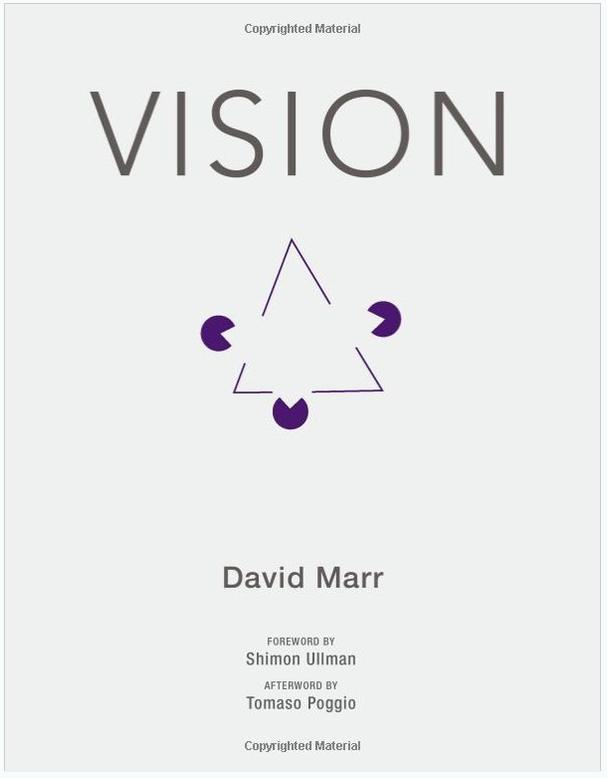
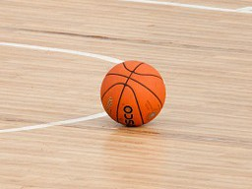
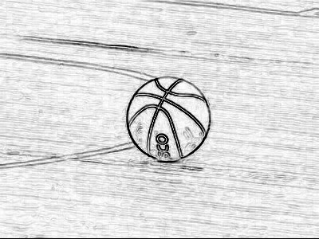
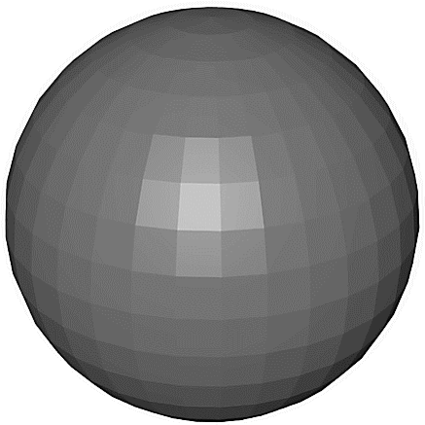
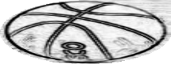
Input image
Edge image
2 ½-D sketch
3-D model
This image is CC0 1.0 public domain
Input Image
Primal Sketch
2 ½-D
Sketch
3-D Model Representation
Zero crossings, blobs, edges, bars, ends, virtual lines, groups, curves boundaries
Local surface orientation and discontinuities in depth and in surface orientation
3-D models hierarchically organized in terms of surface and volumetric primitives
Perceived intensities
1959
Hubel & Wiesel
1963
Roberts
1970s
David Marr
Stages of Visual Representation, David Marr, 1970s

Slide 34
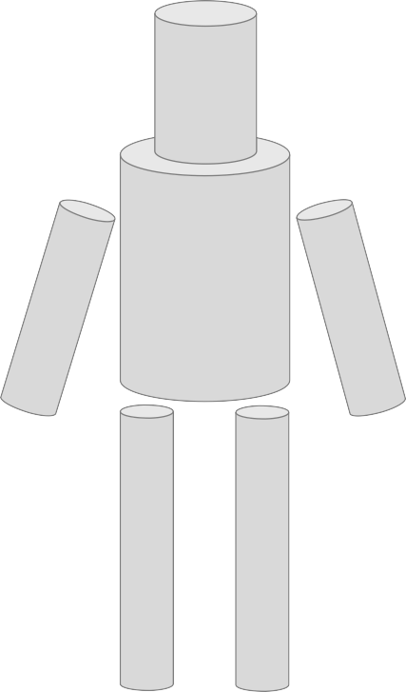
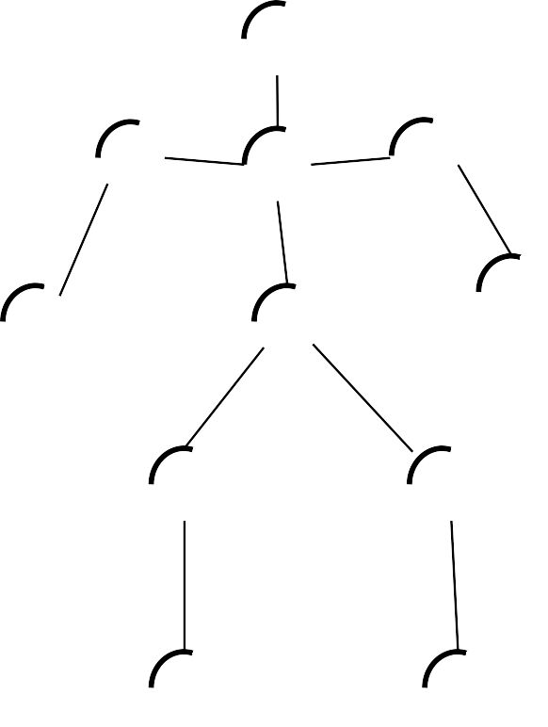
Recognition via Parts (1970s)
Generalized Cylinders, Brooks and Binford, 1979
Pictorial Structures, Fischler and Elshlager, 1973
1959
Hubel & Wiesel
1963
Roberts
1970s
David Marr
1979
Gen. Cylinders

Slide 35
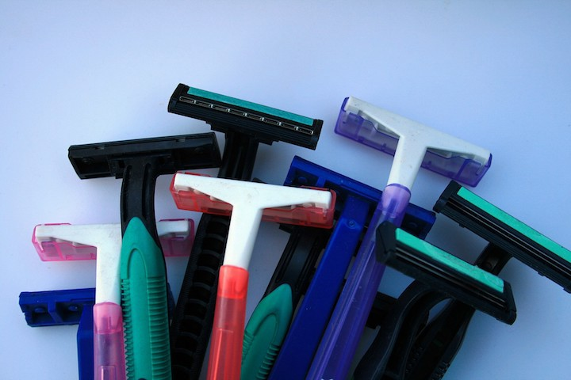
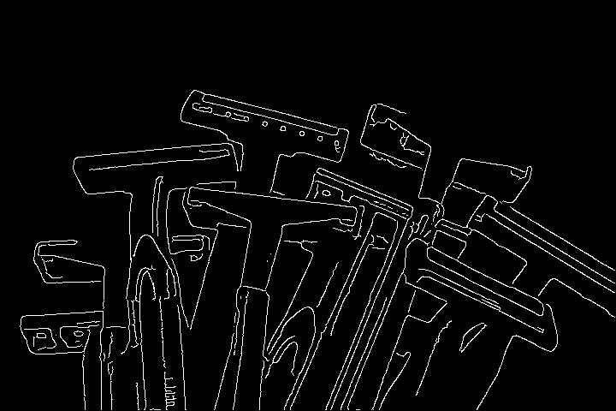
Recognition via Edge Detection (1980s)
1959
Hubel & Wiesel
1963
Roberts
1970s
David Marr
1979
Gen. Cylinders
1986
Canny
John Canny, 1986 David Lowe, 1987
Image is CC0 1.0 public domain

Slide 36

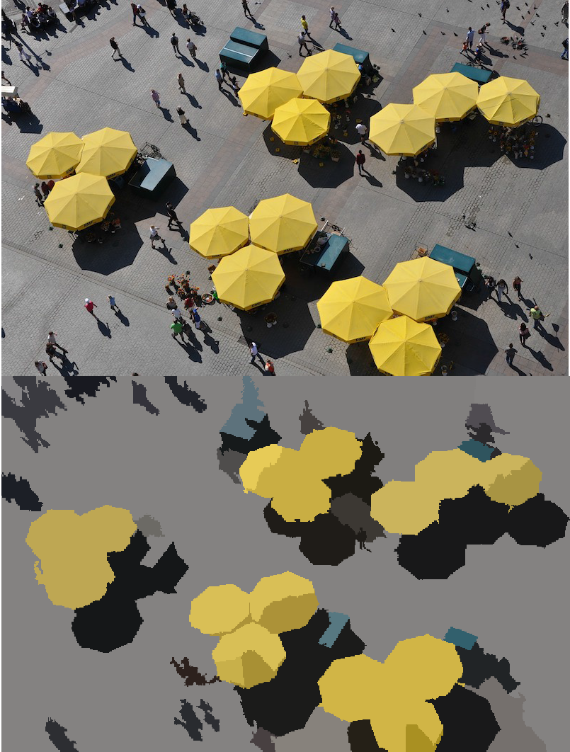
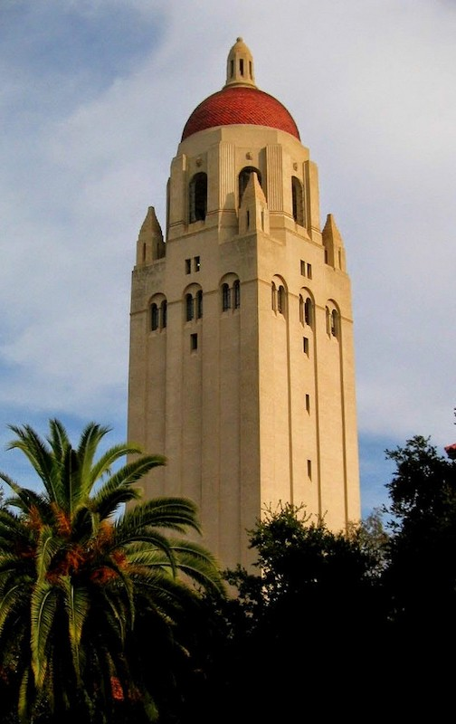


Recognition via Grouping (1990s)
1959
Hubel & Wiesel
1963
Roberts
1970s
David Marr
1979
Gen. Cylinders
1986
Canny
1997
Norm. Cuts
Normalized Cuts, Shi and Malik, 1997
AI Winter

Slide 37
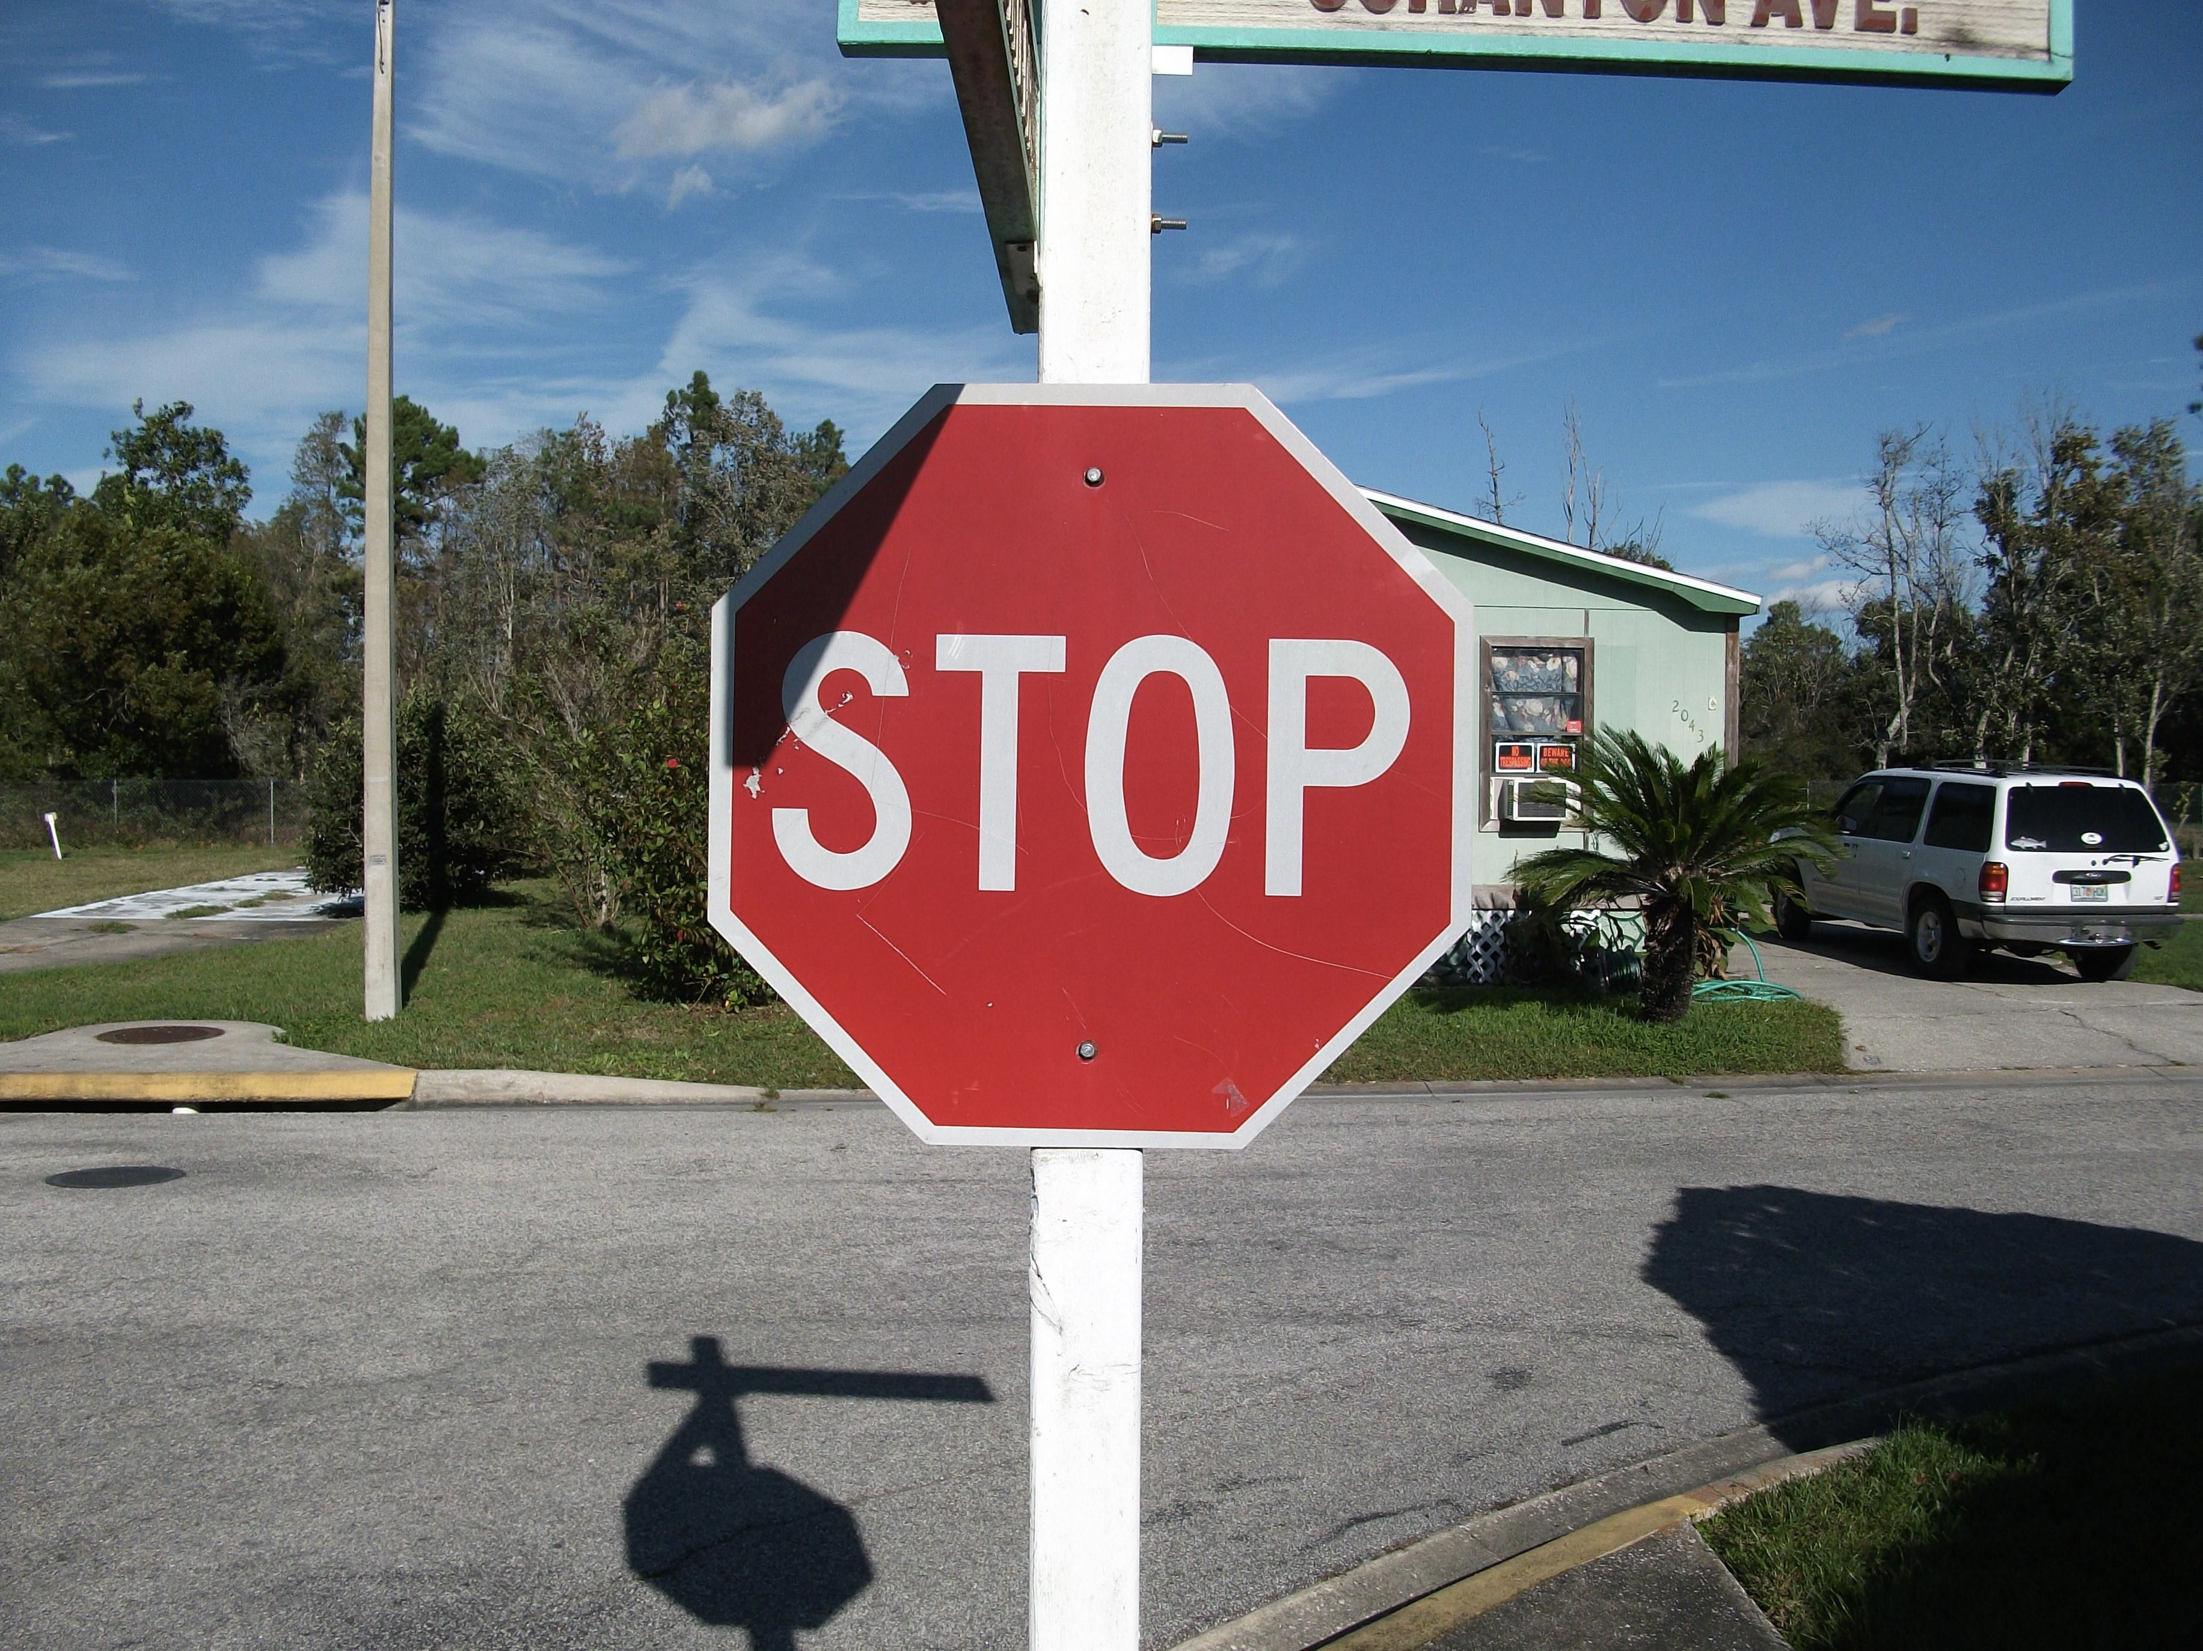

Recognition via Matching (2000s)
1959
Hubel & Wiesel
1963
Roberts
1970s
David Marr
1979
Gen. Cylinders
1986
Canny
1997
Norm. Cuts
1999
SIFT
SIFT, David Lowe, 1999
AI Winter

Slide 38
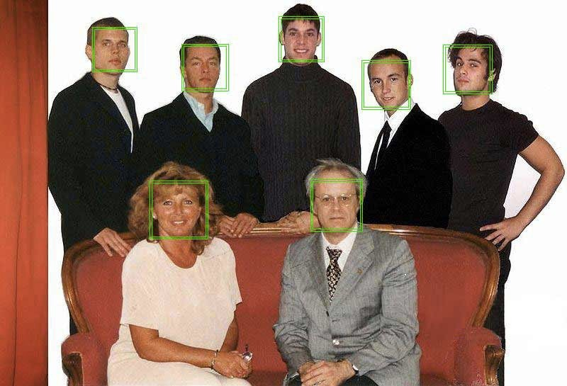
Face Detection
Viola and Jones, 2001
One of the first successful applications of machine learning to vision
1959
Hubel & Wiesel
1963
Roberts
1970s
David Marr
1979
Gen. Cylinders
1986
Canny
1997
Norm. Cuts
1999
SIFT
2001
V&J
AI Winter

Slide 39
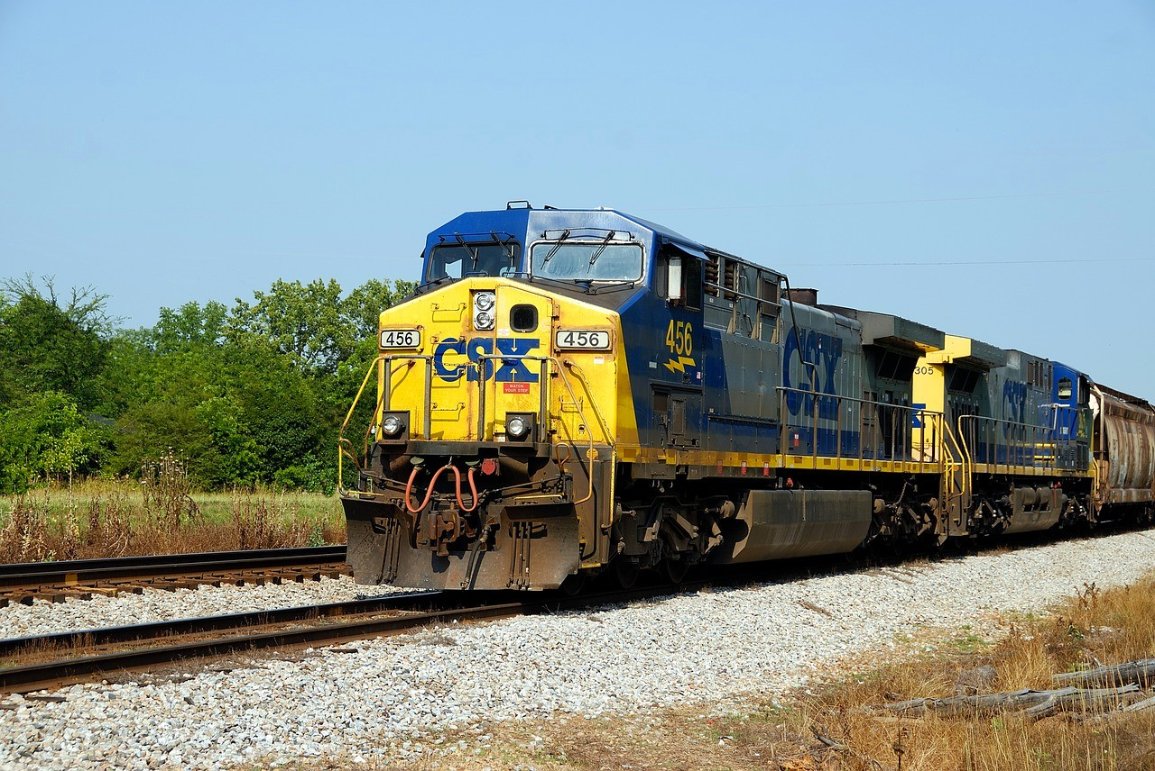

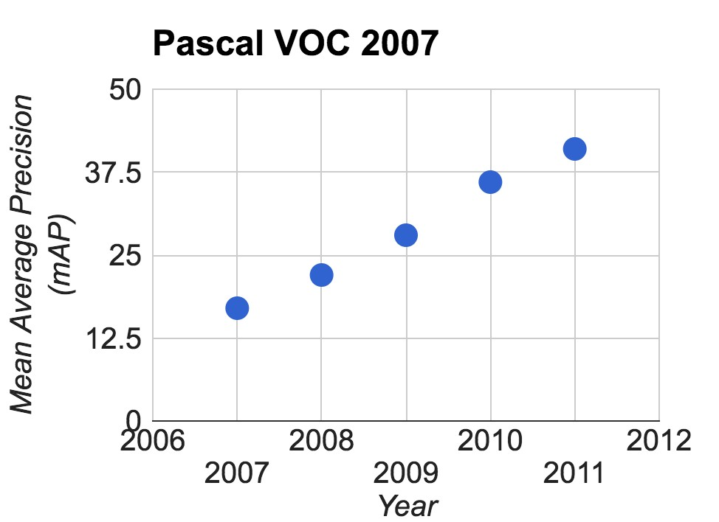

PASCAL Visual Object Challenge
Image is CC0 1.0 public domain
Train
Person
Airplane
Image is CC0 1.0 public domain
1959
Hubel & Wiesel
1963
Roberts
1970s
David Marr
1979
Gen. Cylinders
1986
Canny
1997
Norm. Cuts
1999
SIFT
2001
V&J
2001
PASCAL
AI Winter

Slide 40


Output:
Scale T-shirt
Steel drum
The Image Classification Challenge:
1,000 object classes
1,431,167 images
Drumstick Mud turtle
Deng et al, 2009 Russakovsky et al. IJCV 2015
1959
Hubel & Wiesel
1963
Roberts
1970s
David Marr
1979
Gen. Cylinders
1986
Canny
1997
Norm. Cuts
1999
SIFT
2001
V&J
2001
PASCAL
2009
ImageNet
AI Winter

Slide 41

Enter Deep Learning
1959
Hubel & Wiesel
1963
Roberts
1970s
David Marr
1979
Gen. Cylinders
1986
Canny
1997
Norm. Cuts
1999
SIFT
2001
V&J
2001
PASCAL
2009
ImageNet
AI Winter
2012
AlexNet

Slide 42

AlexNet: Deep Learning Goes Mainstream
Krizhevsky, Sutskever, and Hinton, NeurIPS 2012
1959
Hubel & Wiesel
1963
Roberts
1970s
David Marr
1979
Gen. Cylinders
1986
Canny
1997
Norm. Cuts
1999
SIFT
2001
V&J
2001
PASCAL
2009
ImageNet
AI Winter
2012
AlexNet

Slide 43

Deep Learning History

Slide 44

Perceptron
One of the earliest algorithms that could learn from data
Implemented in hardware! Weights stored in potentiometers, updated with electric motors during learning
Connected to a camera that used 20x20 cadmium sulfide photocells to make a 400-pixel image
Could learn to recognize letters of the alphabet
Today we would recognize it as a linear classifier
1959
Hubel & Wiesel
1963
Roberts
1970s
David Marr
1979
Gen. Cylinders
1986
Canny
1997
Norm. Cuts
1999
SIFT
2001
V&J
2001
PASCAL
2009
ImageNet
AI Winter
2012
AlexNet

Slide 45

Minsky and Papert, 1969
X | Y | F(x,y)
0 | 0 | 0
0 | 1 | 1
1 | 0 | 1
1 | 1 | 0
y
x
Showed that Perceptrons could not learn the XOR function Caused a lot of disillusionment in the field
1959
Hubel & Wiesel
1963
Roberts
1970s
David Marr
1979
Gen. Cylinders
1986
Canny
1997
Norm. Cuts
1999
SIFT
2001
V&J
2001
PASCAL
2009
ImageNet
AI Winter
2012
AlexNet

Slide 46
The Perceptron
The structural building block of deep learning

Slide 47

The Perceptron:Forward Propagation
47

Slide 48

The Perceptron:Forward Propagation
48

Slide 49

The Perceptron:Forward Propagation
49

Slide 50

The Perceptron:Forward Propagation
50

Slide 51

Common Activation Functions
51

Slide 52

The Perceptron:Example
52

Slide 53

The Perceptron:Example
53

Slide 54

The Perceptron:Example
54

Slide 55

The Perceptron:Example
55

Slide 56

Neocognitron: Fukushima, 1980
Computational model the visual system, directly inspired by Hubel and Wiesel’s hierarchy of complex and simple cells
Interleaved simple cells (convolution) and complex cells (pooling)
No practical training algorithm
1959
Hubel & Wiesel
1963
Roberts
1970s
David Marr
1979
Gen. Cylinders
1986
Canny
1997
Norm. Cuts
1999
SIFT
2001
V&J
2001
PASCAL
2009
ImageNet
AI Winter
1958
Perceptron
1969
Minsky & Papert
1980
Neocognitron
2012
AlexNet

Slide 57
Neocognitron: Fukushima, 1980
Looks a lot like AlexNet more than 32 years later!
1959
Hubel & Wiesel
1963
Roberts
1970s
David Marr
1979
Gen. Cylinders
1986
Canny
1997
Norm. Cuts
1999
SIFT
2001
V&J
2001
PASCAL
2009
ImageNet
AI Winter
1958
Perceptron
1969
Minsky & Papert
1980
Neocognitron
2012
AlexNet

Slide 58

Backprop: Rumelhart, Hinton, and Williams, 1986
Introduced backpropagation for computing gradients in neural networks
Successfully trained perceptrons with multiple layers
recognizable math
Illustration of Rumelhart et al., 1986 by Lane McIntosh, copyright CS231n 2017
1959
Hubel & Wiesel
1963
Roberts
1970s
David Marr
1979
Gen. Cylinders
1986
Canny
1997
Norm. Cuts
1999
SIFT
2001
V&J
2001
PASCAL
2009
ImageNet
AI Winter
1958
Perceptron
1969
Minsky & Papert
1980
Neocognitron
1985
Backprop
2012
AlexNet

Slide 59

Convolutional Networks: LeCun et al, 1998
Applied backprop algorithm to a Neocognitron-like architecture Learned to recognize handwritten digits
Was deployed in a commercial system by NEC, processed handwritten checks Very similar to our modern convolutional networks!
1959
Hubel & Wiesel
1963
Roberts
1970s
David Marr
1979
Gen. Cylinders
1986
Canny
1997
Norm. Cuts
1999
SIFT
2001
V&J
2001
PASCAL
2009
ImageNet
AI Winter
1958
Perceptron
1969
Minsky & Papert
1980
Neocognitron
1985
Backprop
1998
LeNet
2012
AlexNet

Slide 60

2000s: “Deep Learning”
People tried to train neural networks that were deeper and deeper
Not a mainstream research topic at this time
Hinton and Salakhutdinov, 2006 Bengio et al, 2007
Lee et al, 2009
Glorot and Bengio, 2010
1959
Hubel & Wiesel
1963
Roberts
1970s
David Marr
1979
Gen. Cylinders
1986
Canny
1997
Norm. Cuts
1999
SIFT
2001
V&J
2001
PASCAL
2009
ImageNet
AI Winter
1958
Perceptron
1969
Minsky & Papert
1980
Neocognitron
1985
Backprop
1998
LeNet
2006
Deep Learning
2012
AlexNet

Slide 61


2012 to Present: Deep Learning Explosion
Google Trends: “Deep Learning”
Publications at top Computer Vision conference
1959
Hubel & Wiesel
1963
Roberts
1970s
David Marr
1979
Gen. Cylinders
1986
Canny
1997
Norm. Cuts
1999
SIFT
2001
V&J
2001
PASCAL
2009
ImageNet
AI Winter
1958
Perceptron
1969
Minsky & Papert
1980
Neocognitron
1985
Backprop
1998
LeNet
2006
Deep Learning
2012
AlexNet

Slide 62

2012 to Present: ConvNets are everywhere
Image Classification Image Retrieval
Figures copyright Alex Krizhevsky, Ilya Sutskever, and Geoffrey Hinton, 2012. Reproduced with permission.

Slide 63


2012 to Present: ConvNets are everywhere
Object Detection Image Segmentation
Ren, He, Girshick, and Sun, 2015
Fabaret et al, 2012

Slide 64


2012 to Present: ConvNets are everywhere
Video Classification
Activity Recognition
Simonyan et al, 2014

Slide 65



2012 to Present: ConvNets are everywhere
Pose Recognition (Toshev and Szegedy, 2014)
Playing Atari games (Guo et al, 2014)

Slide 66



2012 to Present: ConvNets are everywhere
Medical Imaging
Whale recognition
Levy et al, 2016 Figure reproduced with permission
Galaxy Classification
Dieleman et al, 2014
From left to right: public domain by NASA, usage permitted by
Kaggle Challenge
This image by Christin Khan is in the public domain and
ESA/Hubble, public domain by NASA, and public domain.
originally came from the U.S. NOAA.

Slide 67






2012 to Present: ConvNets are everywhere
A white teddy bear sitting in the grass
A man in a baseball uniform throwing a ball
A woman is holding a cat in her hand
Image Captioning
Vinyals et al, 2015 Karpathy and Fei-Fei, 2015
All images are CC0 Public domain: https://pixabay.com/en/luggage-antique-cat-1643010/
https://pixabay.com/en/teddy-plush-bears-cute-teddy-bear-1623436/ https://pixabay.com/en/surf-wave-summer-sport-litoral-1668716/ https://pixabay.com/en/woman-female-model-portrait-adult-983967/
https://pixabay.com/en/handstand-lake-meditation-496008/ https://pixabay.com/en/baseball-player-shortstop-infield-1045263/
A man riding a wave on top of a surfboard
A cat sitting on a suitcase on the floor
A woman standing on a beach holding a surfboard
Captions generated by Justin Johnson using Neuraltalk2

Slide 68






Original image is CC0 public domain
Starry Night and Tree Roots by Van Gogh are in the public domain
Bokeh image is in the public domain Stylized images copyright Justin Johnson, 2017; reproduced with permission
Mordvinsev et al, 2015 Gatys et al, 2016
Figures copyright Justin Johnson, 2015. Reproduced with permission. Generated using the Inceptionism approach from a blog post by Google Research.

Slide 69

Object Detection

Slide 70

Self-driving cars

Slide 71



Machine translation
Emoticon suggestion
AlphaGo

Slide 72

Alpha Star

Slide 73

Automated Text Generation [Karpathy et al.]
73

Slide 74
Deep Learning Today
Google Assistant (Google IO’19)

Slide 75

Healthcare, cancer detection

Slide 76





Video anonymization
Control identity
Source
[Maximov et al., CVPR 2020] CIAGAN: Conditional identity
anonymization generative adversarial networks.

Slide 77

Deep Learning at TUM

Slide 78

Deep Learning at TUM

Slide 79

Deep Learning at TUM

Slide 80

Deep Learning at TUM

Slide 81

Multiple object tracking with graph neural networks

Slide 82




Algorithms
Data
Computation

Slide 83





GigaFLOPs per Dollar
18
CPU
GPU
Deep Learning Explosion
16
14
12
GTX 1080 Ti
10
8
GeForce GTX 580
6
(AlexNet)
4
GeForce 8800 GTX
2
0
1/2004
10/2006
7/2009
4/2012
12/2014
9/2017
Time

Slide 84



2018 Turing Award
Yoshua Bengio
Geoffrey Hinton
Yann LeCun
1959
Hubel & Wiesel
1963
Roberts
1970s
David Marr
1979
Gen. Cylinders
1986
Canny
1997
Norm. Cuts
1999
SIFT
2001
V&J
2001
PASCAL
2009
ImageNet
AI Winter
1958 | 1969 | 1980 | 1985 |  | 1998 | 2006 | 2012 | 2018
Perceptron | Minsky & Papert | Neocognitron | Backprop |  | LeNet | Deep Learning | AlexNet | Turing Award

Slide 85
Despite our success, computer vision still has a long way to go…

Slide 86


Slide 87










Computer Vision Technology
Can Better Our Lives
Outside border images, clockwise, starting from top left:
Image by Pop Culture Geek is licensed under CC BY 2.0; changes made Image by the US Government is in the public domain
Image by the US Government is in the public domain Image by Glogger is licensed under CC BY-SA 3.0; changes made Image by Sylenius is licensed under CC BY 3.0; changes made Image by US Government is in the public domain
Inside four images, clockwise, starting from top left:
Image is CC0 1.0 public domain Image by Tucania is licensed under CC BY-SA 3.0; changes made Image by Intuitive Surgical, Inc. is licensed under CC BY-SA 3.0; changes made
Image by Oyundari Zorigtbaatar is licensed under CC BY-SA 4.0

